Slide 1
Density Based Traffic Light Controlling
VEMULA HARAN RITVICK
CS21B1033
CS5005 - IIoT and Cloud Computing Assignment

Slide 2
Table of Contents
Introduction
Aim of the Project
Hardware/ Software Required
Problem Statement
Methodology
Results
Conclusion/ Future Work

Slide 3
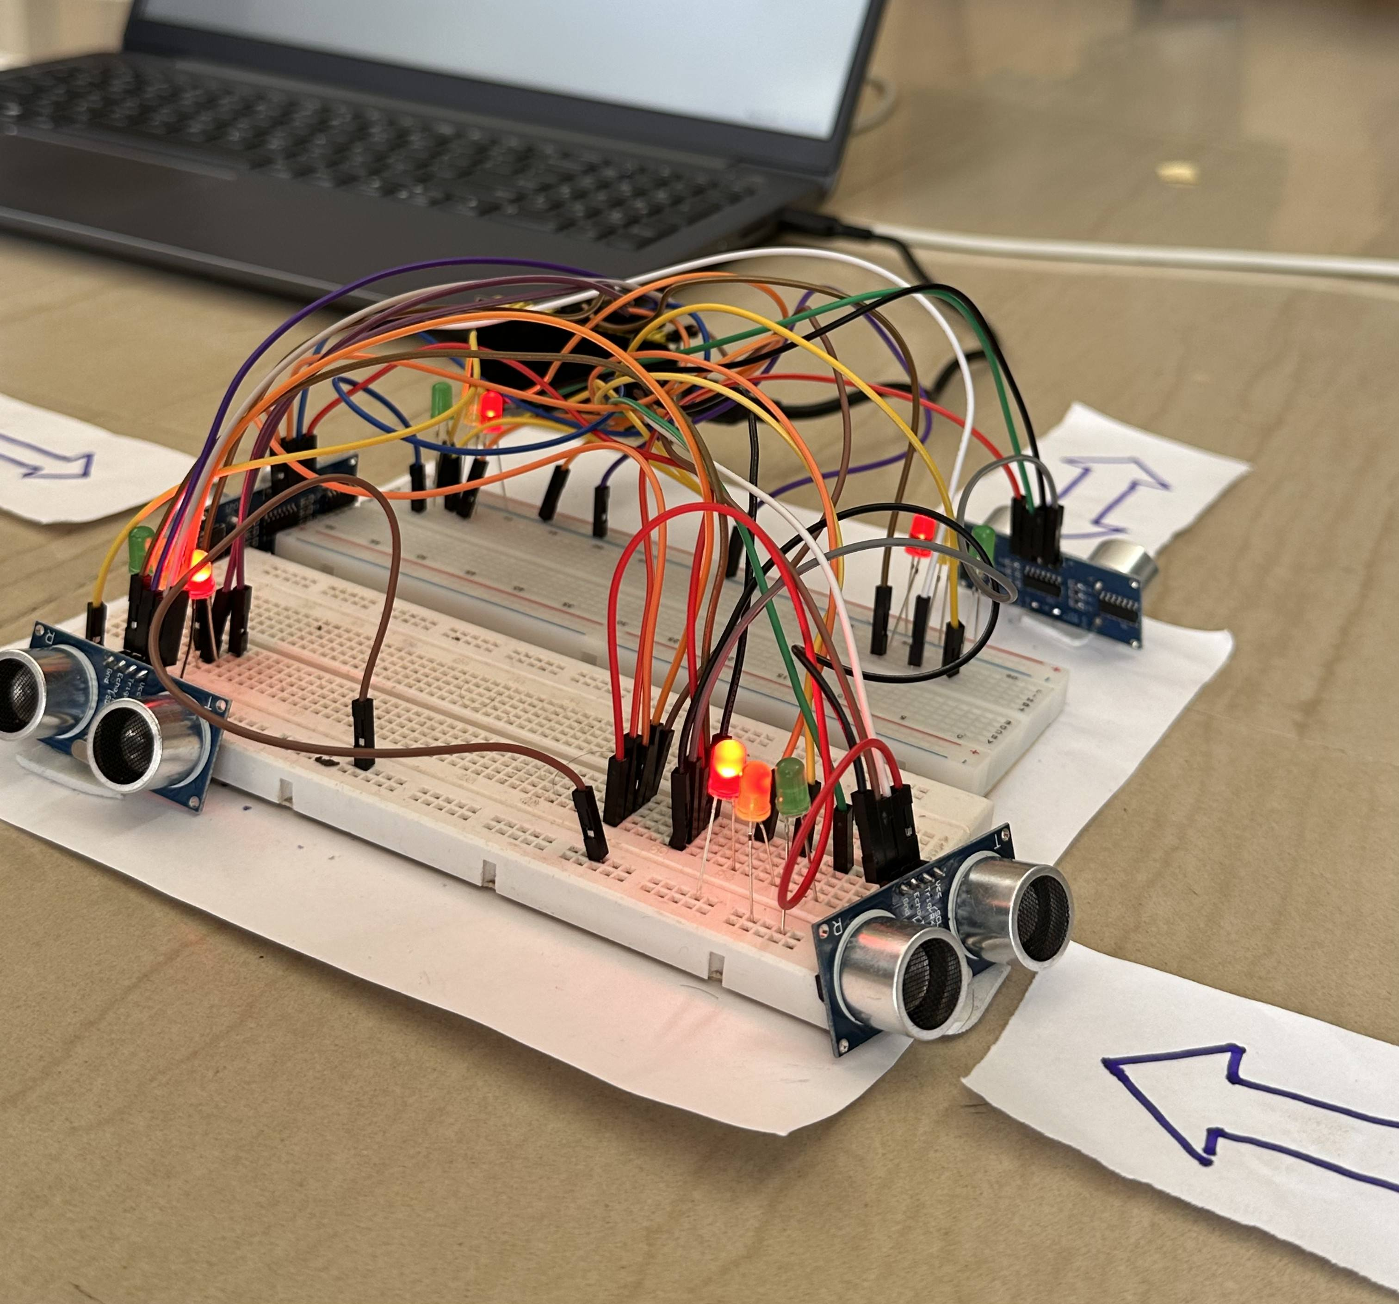
Introduction
Traffic congestion is a significant challenge faced by urban areas worldwide, leading to wasted time, fuel, and environmental pollution.
Traditional traffic signal systems often operate on fixed timing schedules, which may not efficiently accommodate fluctuating traffic volumes throughout the day.
As a result, intersections may experience unnecessary delays, even when there is minimal or no traffic present.

Slide 4
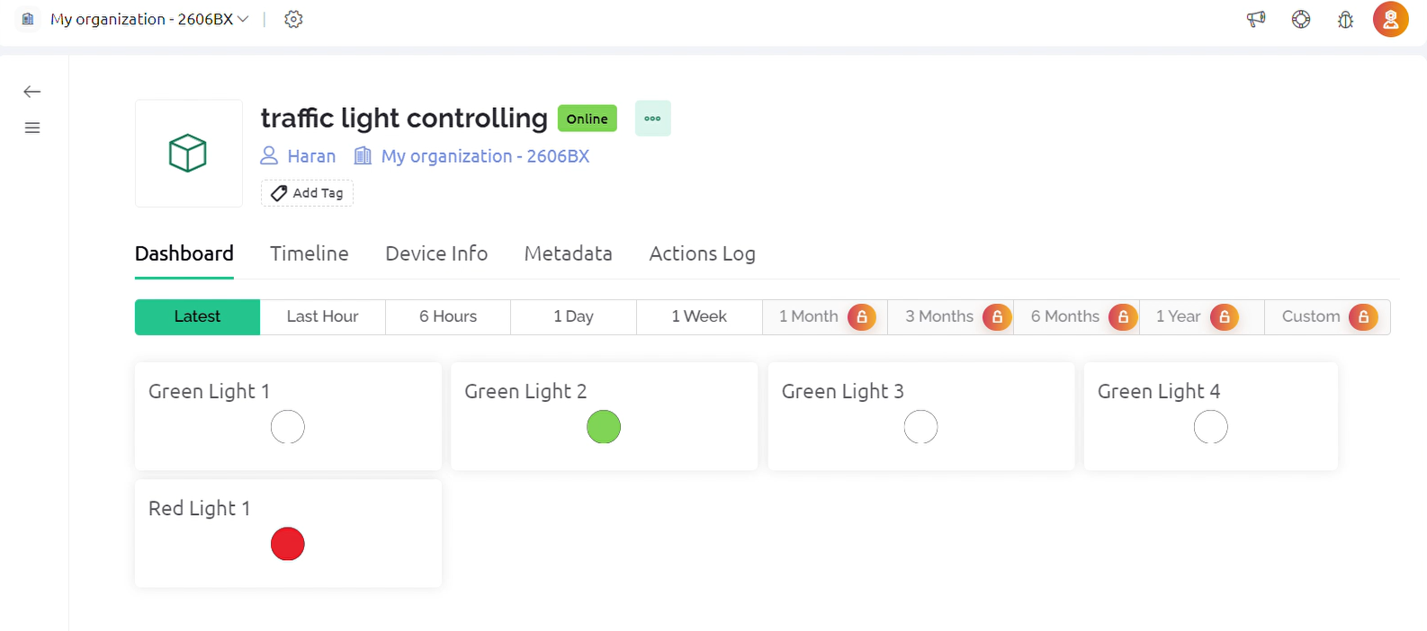
Aim of the Project
This project aims to optimize traffic flow by prioritizing signals with higher traffic density, while efficiently skipping signals with no or minimal traffic.
The objective of this project is to create a smart traffic management system that dynamically adjusts signal timings based on traffic density, thereby optimizing traffic flow and reducing waiting times at intersections.
Through the integration with the Blynk IoT platform, users can remotely monitor the system, ensuring effective traffic management from anywhere.

Slide 5
Hardware/Software Required
List of Hardware
ESP32 Wi-Fi Module
Ultrasonic Sensor HC-SR04 (4)
Red LED (4), Yellow LED (4), Green LED (4)
Connecting Wires
Micro-USB Cable
Breadboard.
List of Software
Blynk Cloud platform for real-time monitoring

Slide 6
Problem Definition
What is the problem that your project has solved?
Inefficient Traffic Signal Management: Traditional traffic signal systems operate on fixed timing schedules, which often lead to inefficiencies in traffic management. Intersections may experience unnecessary delays and congestion, even during times of low traffic volume. As a result, commuters endure longer wait times, increased fuel consumption, and heightened frustration due to prolonged journeys.
Wasted Resources and Environmental Impact: Inefficient traffic signal management not only wastes commuters' time but also leads to unnecessary fuel consumption and increased emissions. Vehicles idling at congested intersections consume fuel inefficiently, contributing to higher levels of air pollution and greenhouse gas emissions.

Slide 7
Problem Definition
What is the relevance of the problem?
Economic Impact: Traffic congestion results in significant economic costs due to wasted time, fuel consumption, and productivity losses for individuals and businesses. By optimizing traffic flow, the project aims to reduce these costs, thereby improving economic efficiency and productivity.
Environmental Impact: Vehicle emissions from idling in traffic contribute to air pollution and greenhouse gas emissions, exacerbating climate change and negatively impacting public health. By reducing congestion and promoting smoother traffic flow, the project can help mitigate these environmental impacts.
Social Impact: Traffic congestion leads to frustration, stress, and decreased quality of life for residents in affected areas. By creating a more efficient traffic management system, the project aims to enhance the overall livability of urban environments, improving residents' well-being and satisfaction.

Slide 8
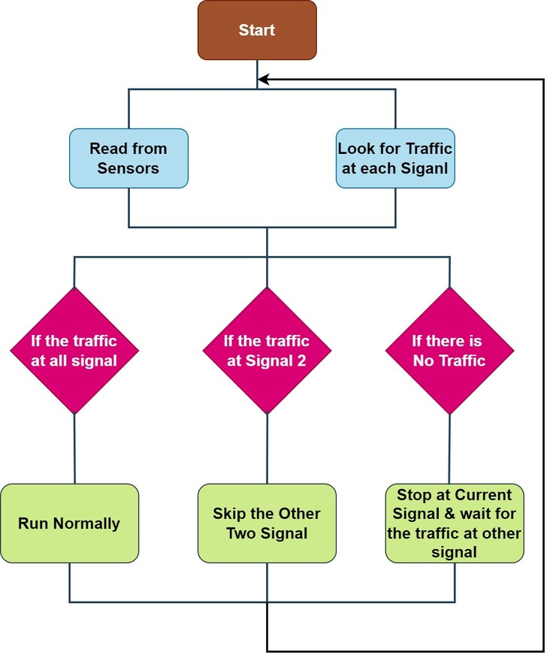
Methodology
List out the contributions made in the project:
Utilizing ESP32 microcontroller for data processing and control.
Integrating HC-SR04 ultrasonic sensors for real-time detection of vehicle presence.
Implementing a dynamic traffic signal control algorithm based on traffic density.
Integrating with the Blynk Cloud platform for remote monitoring and control.
Discuss the procedure followed in brief:
The system operates in three main steps: normal operation with traffic at all signals, adaptive skipping of signals without traffic, and idle state during absence of traffic.
Ultrasonic sensors detect vehicle presence, and the system adjusts signal timings accordingly.

Slide 9
Analysis/ Results
What is your understanding of the results?
When there is density in any of the lane, the traffic signal of that particular lane turns green.
If there is density in more than one lane, then the vehicles that reached that particular lane first will be allowed to pass the signal and the same is followed for the remaining lanes.

Slide 10
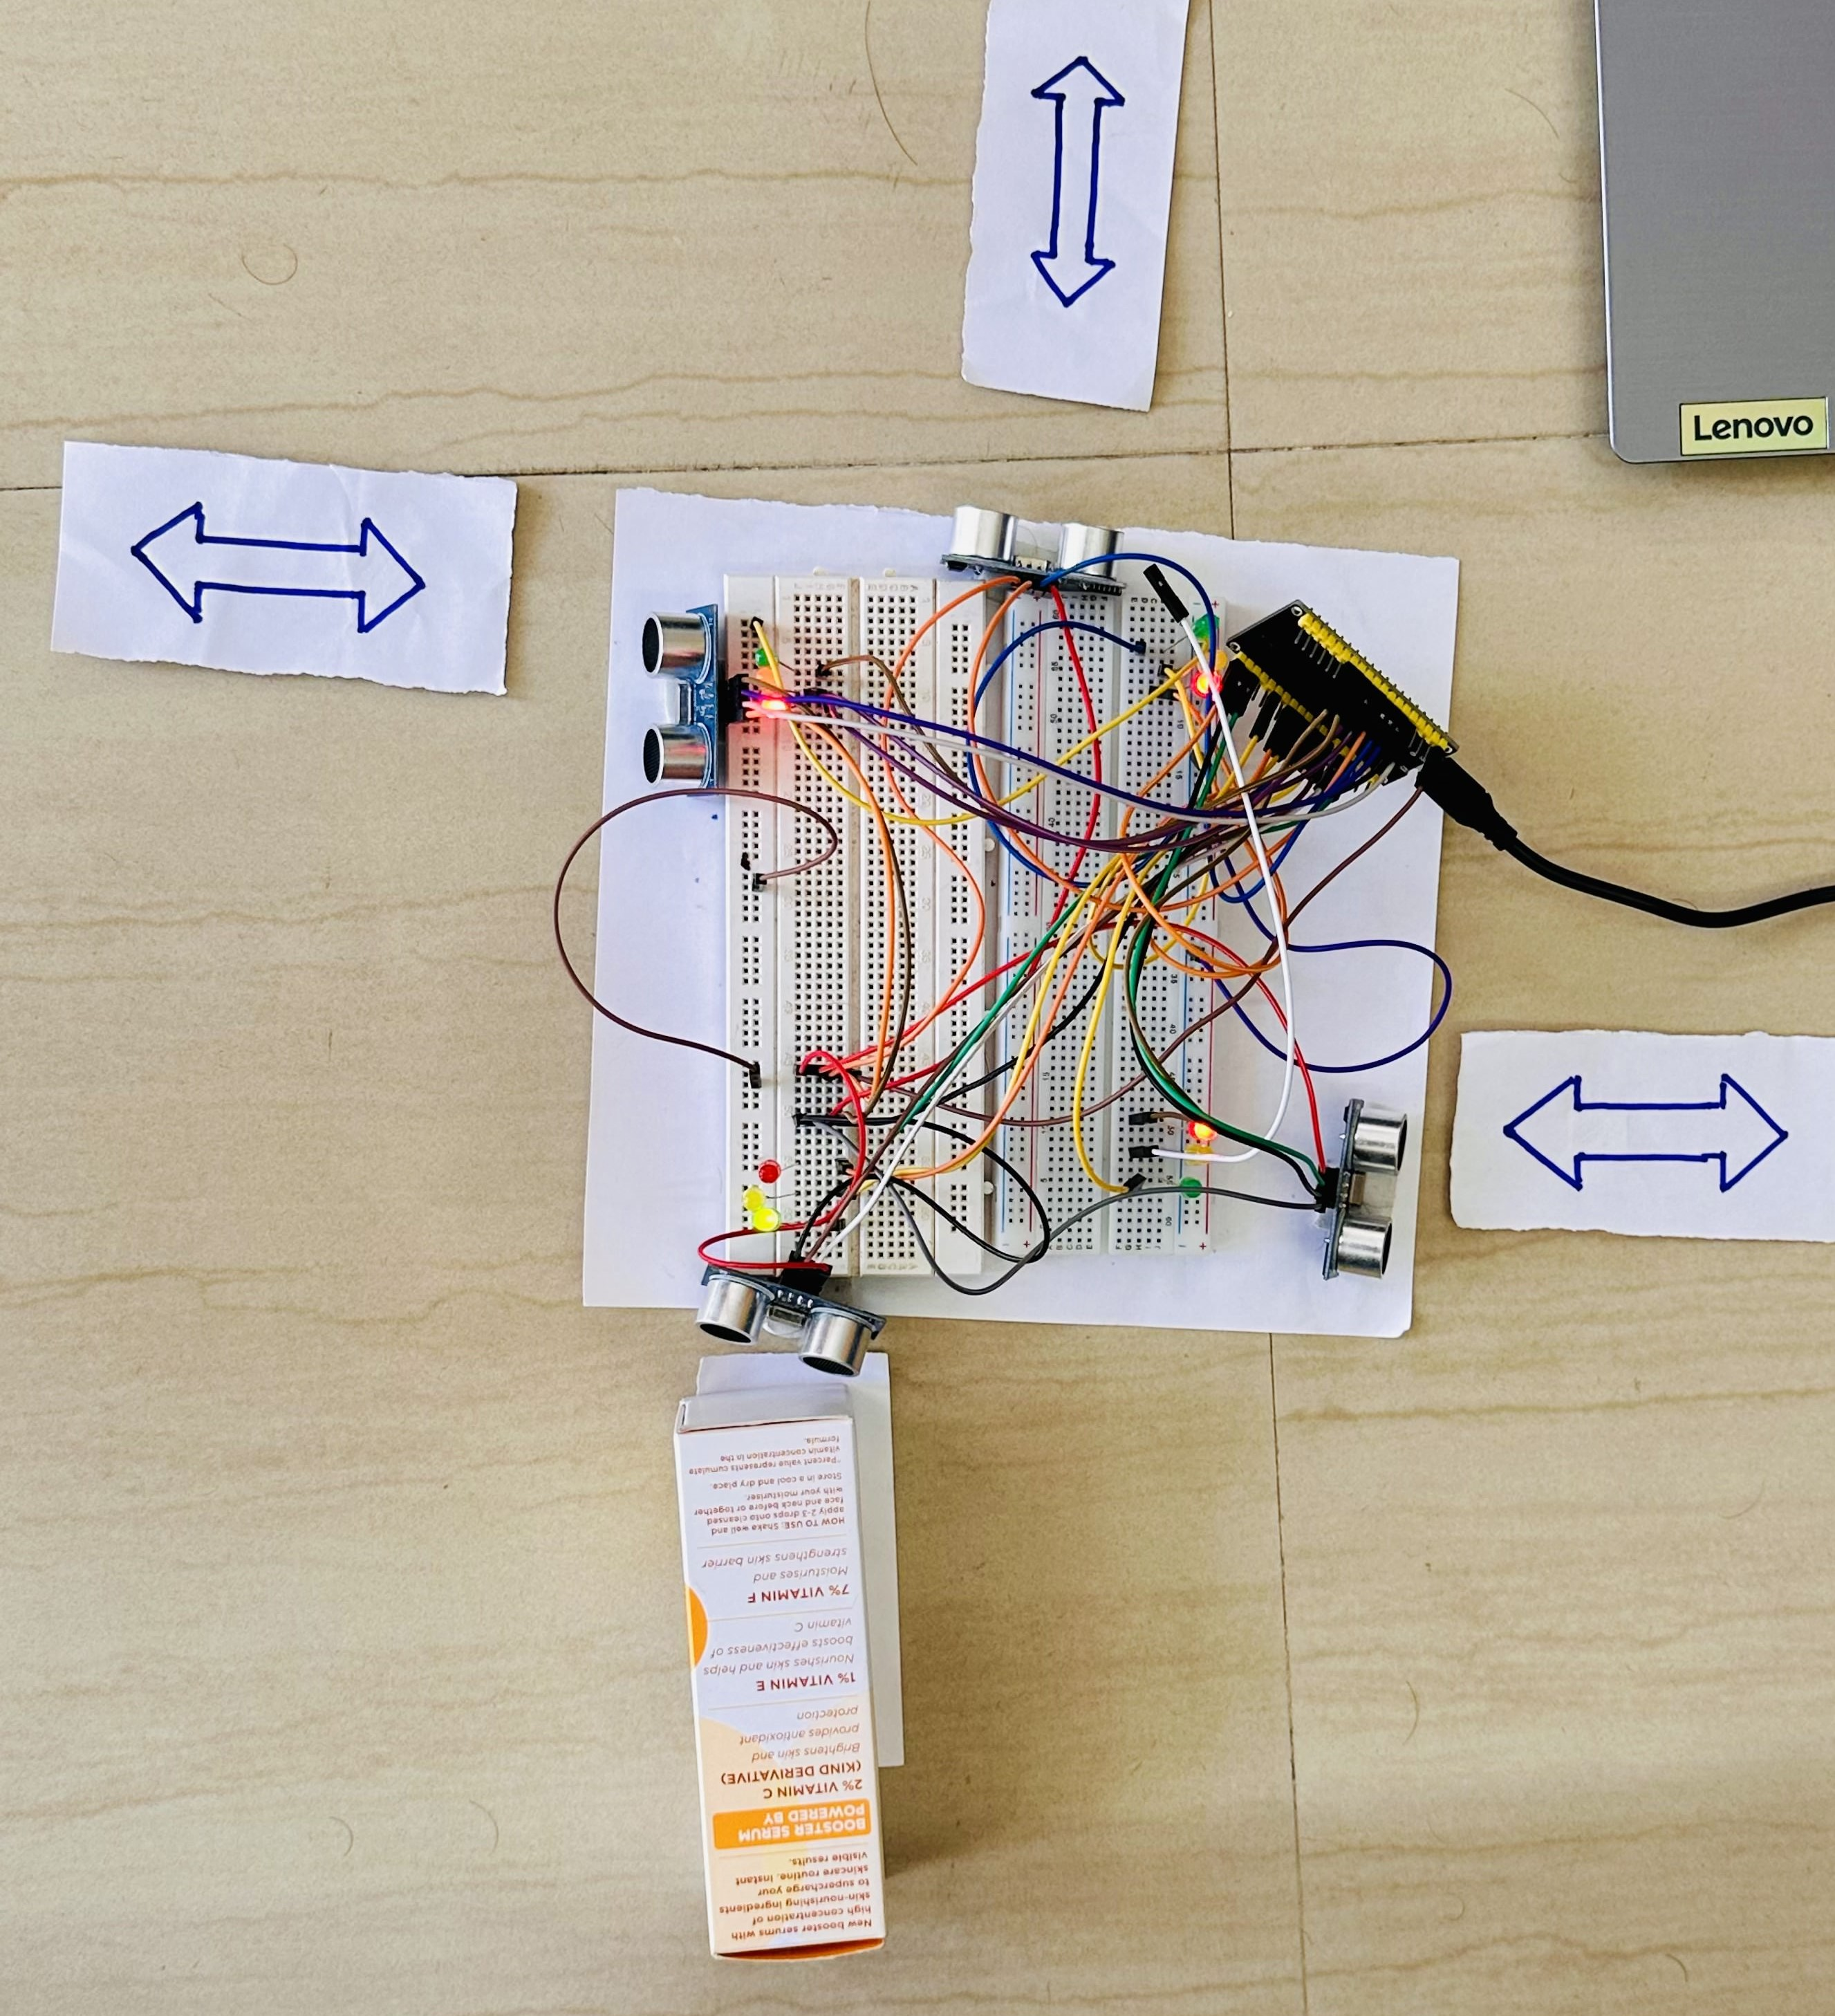
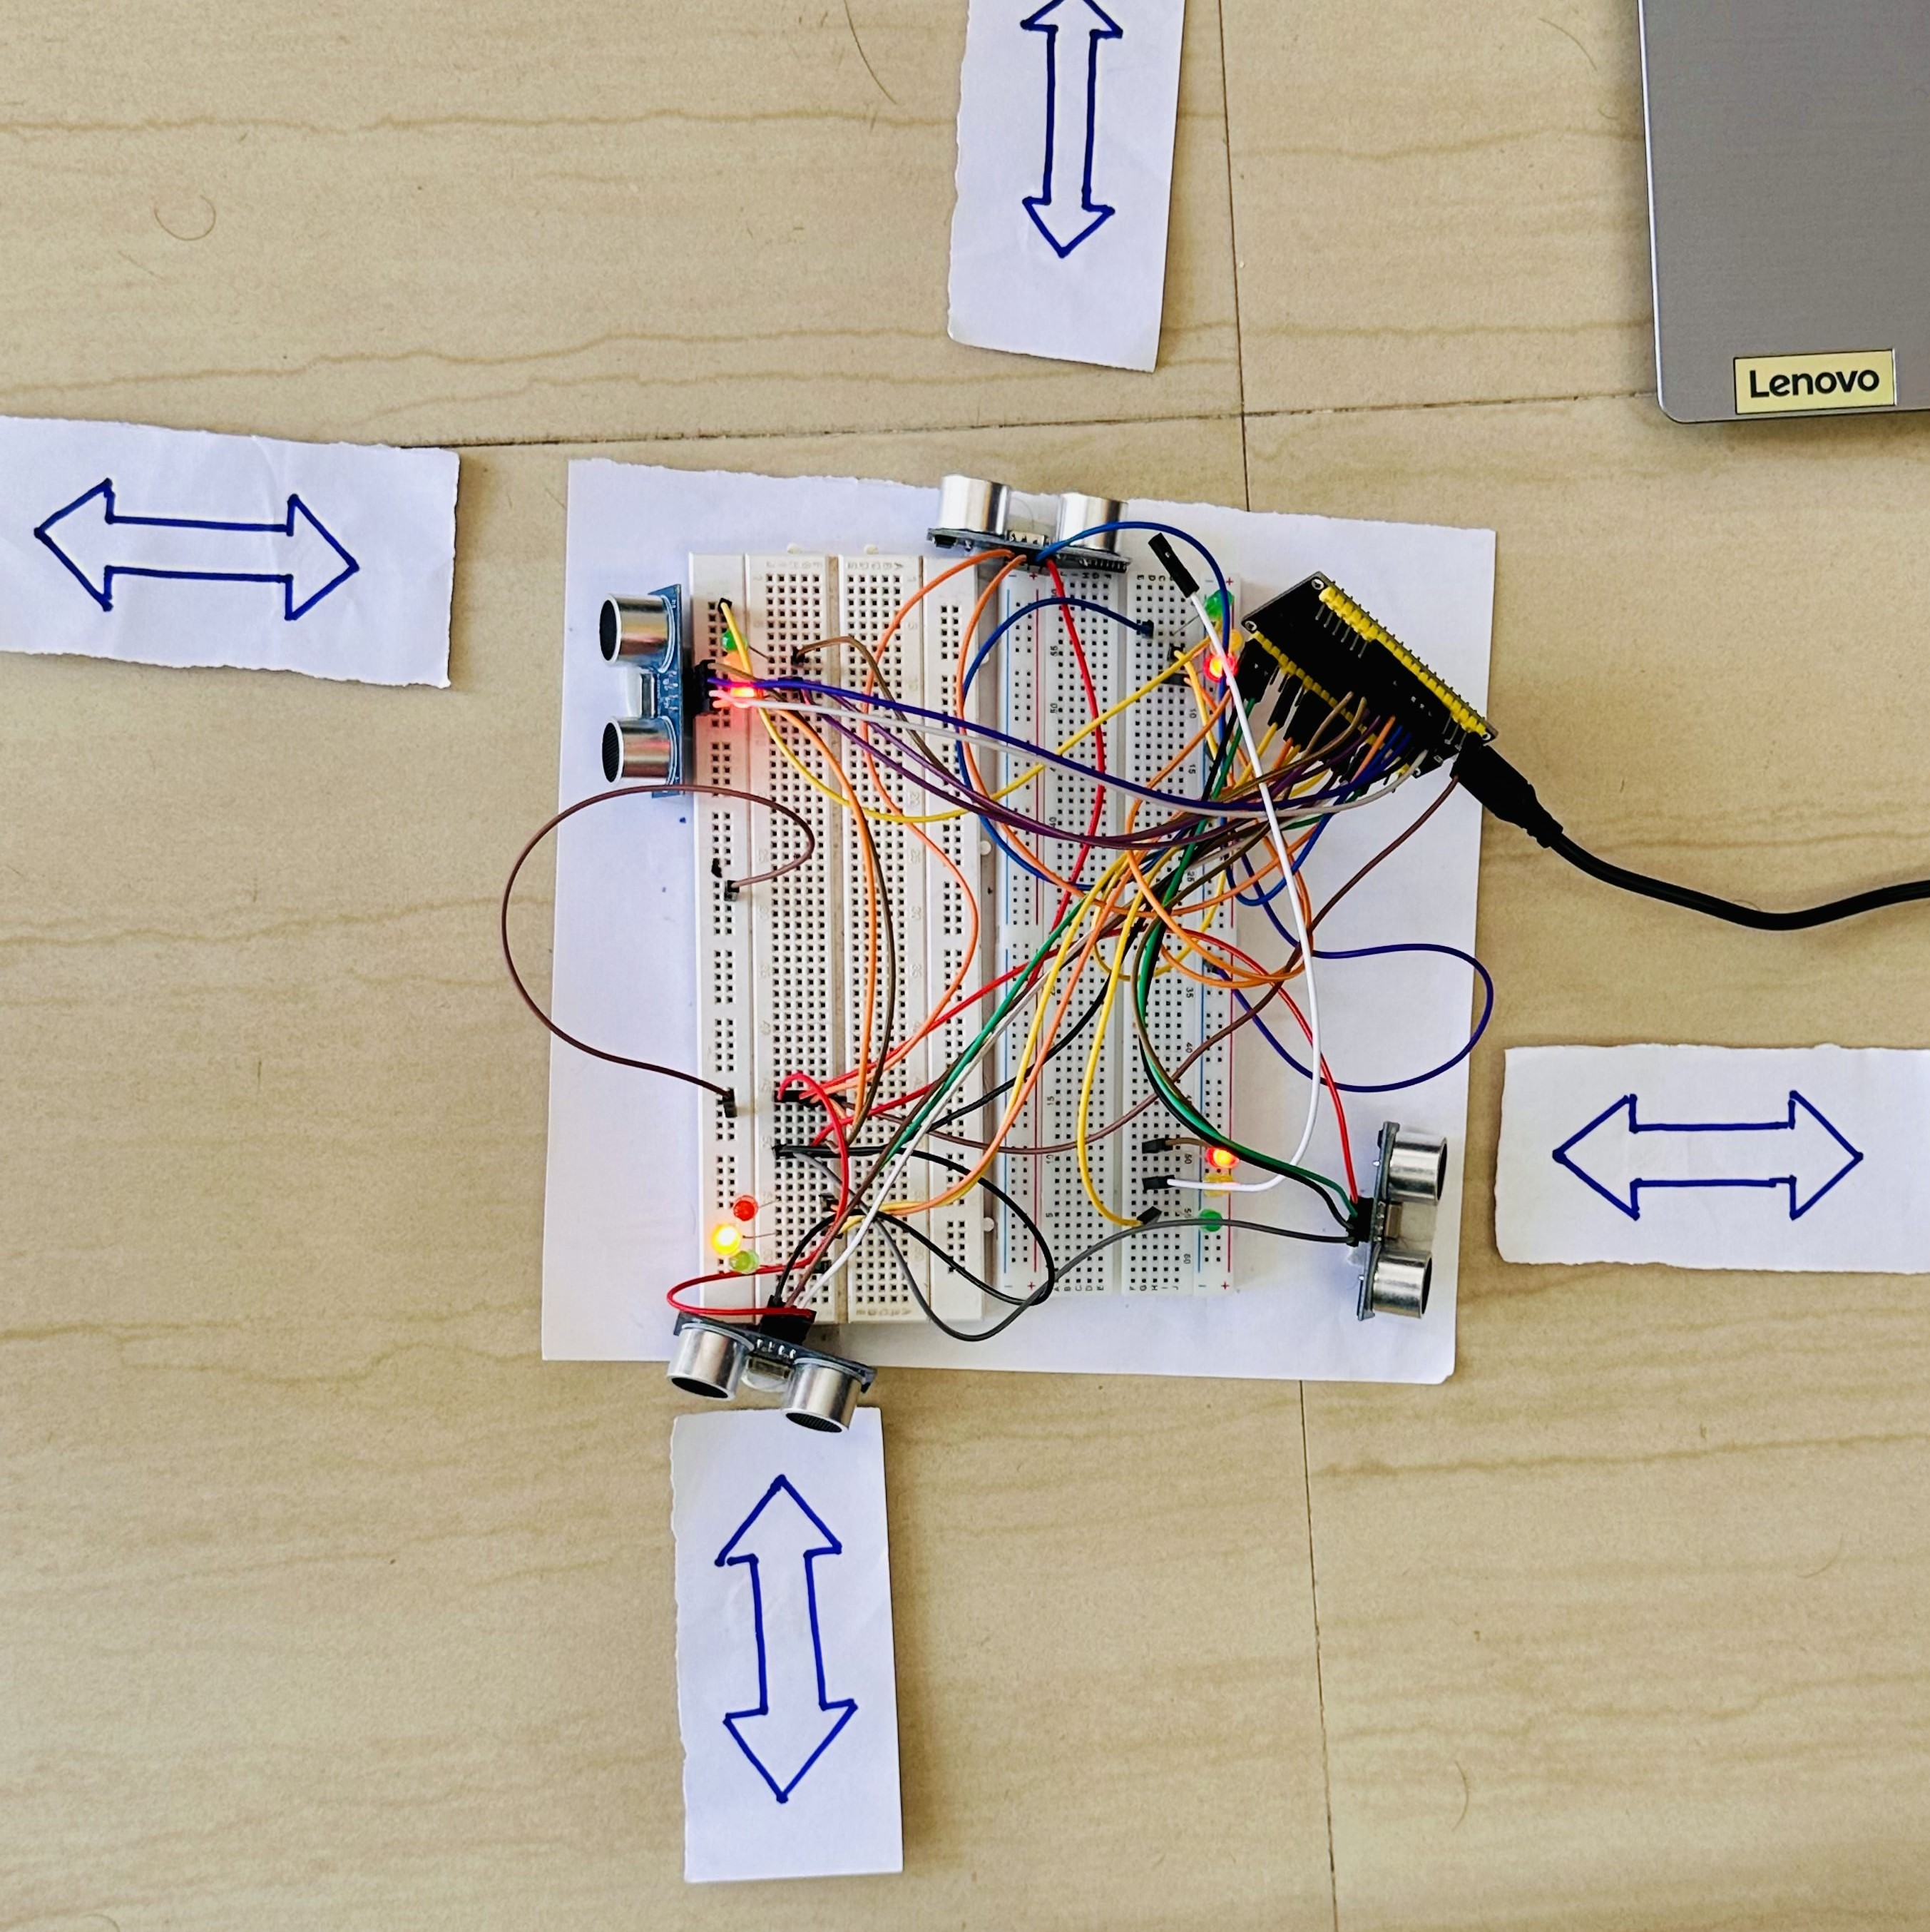
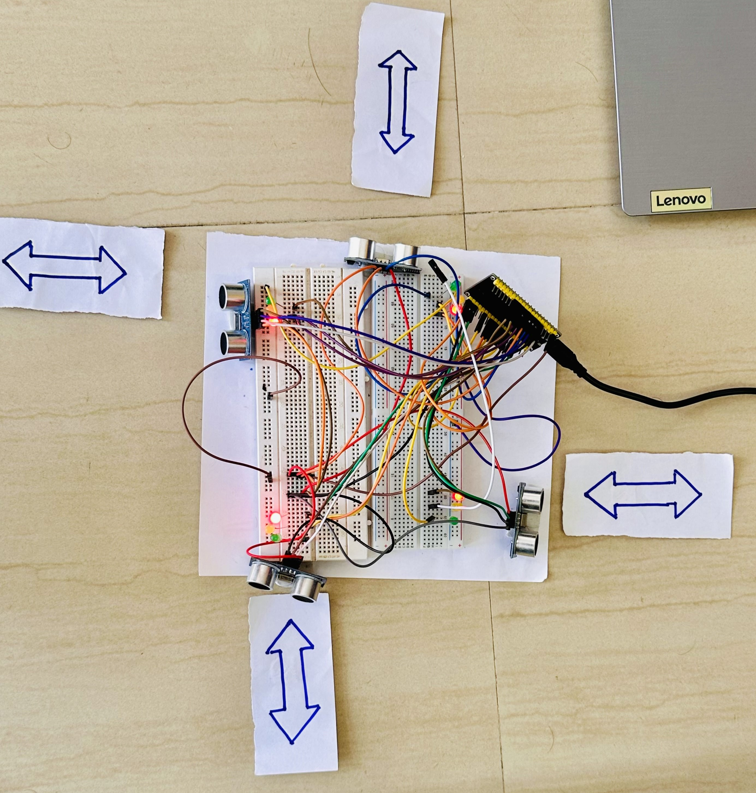
Analysis/ Results
Green Light – Vehicle arrived
Yellow Light – Vehicle just left
Red Light – Lane is free now

Slide 11
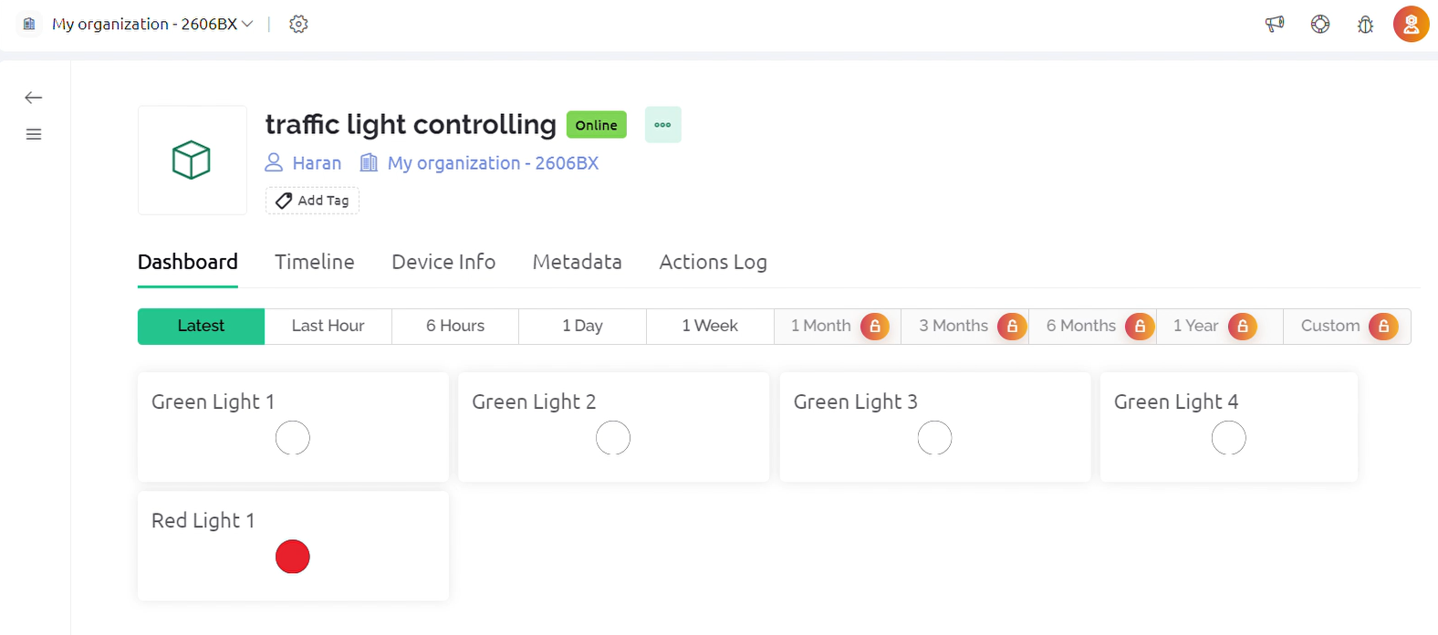
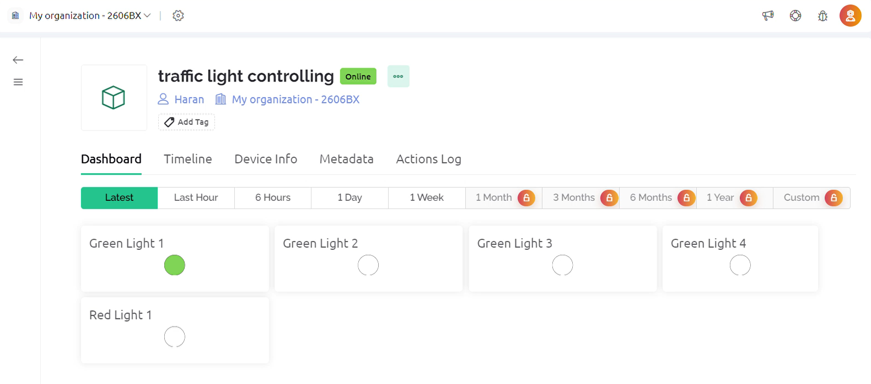
Analysis/Results (Blynk Cloud Virtual Signal)
Red Light – Lane is free now
Green Light – Vehicle arrived

Slide 12
Conclusion
Mention concluding remarks:
The density-based traffic light controller project showcases the potential of smart traffic management systems in optimizing traffic flow and reducing congestion.
By dynamically adjusting signal timings based on real-time traffic conditions, the system offers a practical solution to improve urban mobility.
Future plans:
Future iterations of the project could explore additional features such as predictive analytics for traffic forecasting, integration with weather forecasting, and scalability for larger urban areas.
Additionally, incorporating machine learning algorithms could further enhance the system's ability to adapt to changing traffic patterns and optimize signal timings.

Slide 13
References
P.Pujithsai, O.Goutham Sai, Varshith, Bagubali A “Density Controlled Traffic Lights System using Aurdino Mega 2560”
Pramod Sharma “Density Based Intelligent Traffic Control System Using IR Sensors” Intl journal of scientific research.
M. A.A. Parkhi, Mr. A.A. Peshattiwar, Mr.K.G. Pande “Intelligent Traffic System Using Vehicle Density”. Yeshwantrao Chavan College of Engg., Nagpur. International Journal of Electrical and Electronic Engoneers, 2016.
S.Sundara Mahalingam1 , S.Arockiaraj2 1 Assistant Professor, “DENSITY BASED TRAFFIC LIGHT CONTROL USING ARDUINO ” Electrical and Electronics Engineering, Mepco Schlenk Engineering College , Tamil Nadu, India .

Slide 14
Thank You

